Slide 1





Database Fundamentals And
Microsoft Access
For Beginners
1 What is a Database
Prepared By :
Said Fawzy
Manager of Information Center
Tendering Department
Arab Contractors

Slide 2

Contents
Database concepts.
Database Main Components
Database Users.
Database System Advantages.
Database System Disadvantages.
DBMS Architecture (Three Schema Architecture).
Data Models.
Mappings.
DBMS other Functoions.
DBMS Environment.
Distributed Database
Data and Information.
Database in your daily life.

Slide 3
Data and Information
Process
Data
Information

Slide 4




Data Centers
Data centers are estimated to be responsible for up to 3% of global electricity consumption today and are projected to touch 4% by 2030.

Slide 5

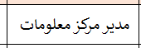
Data and Information
Data
What is the Job of Said Fawzy?
Information

Slide 6
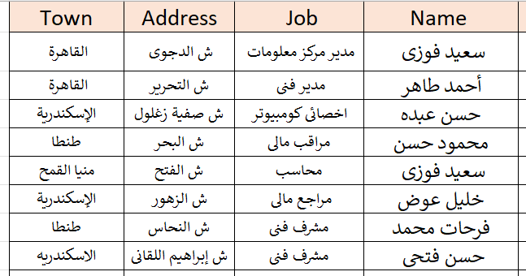
Data and Information
Data
Employees from Alex?
Information

Slide 7
Data and Information
We save Data in Database

Slide 8
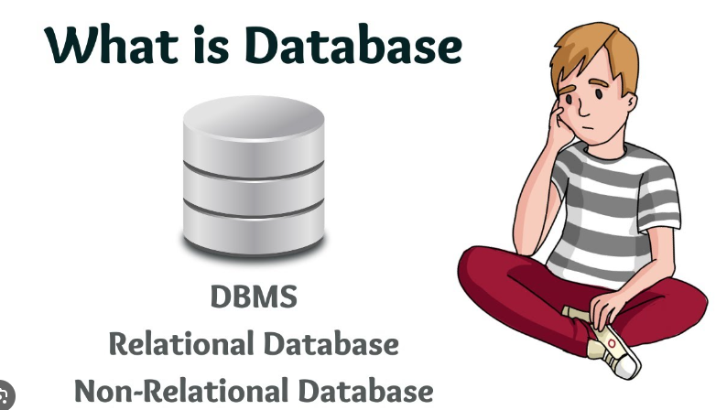

Video

Slide 9
Advantage of Database
Easy to reach information
Fixability to update and retrieve data.
Easy reporting.
Security
Backup
Data Integration.
Easy for Data analysis.
Productivity.
Represent Relationships between data in easy way.

Slide 10
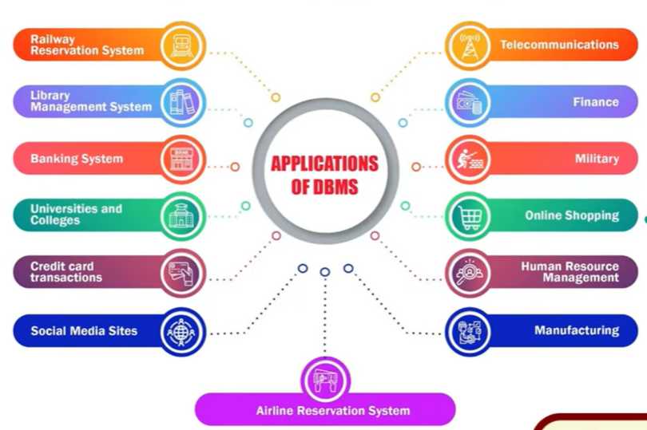

Slide 11

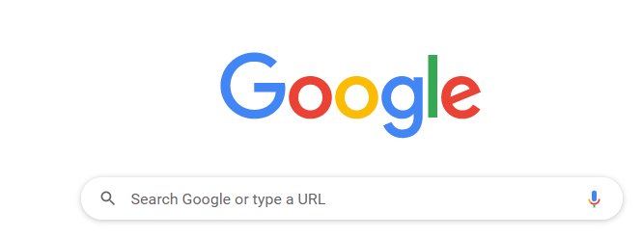
Database in your daily life?
There is always a Database in the Back end

Slide 12
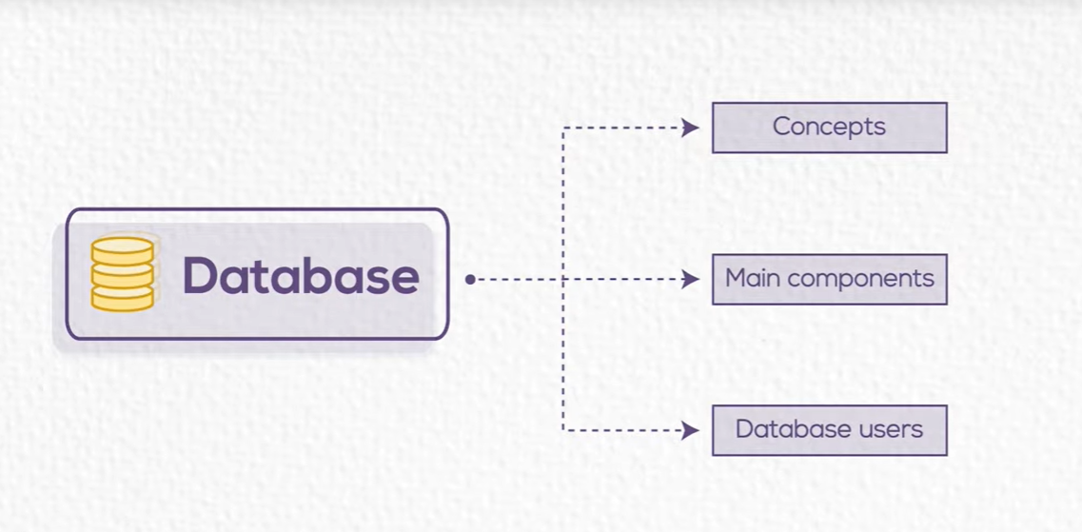
We need to know more about Database

Slide 13



Slide 14
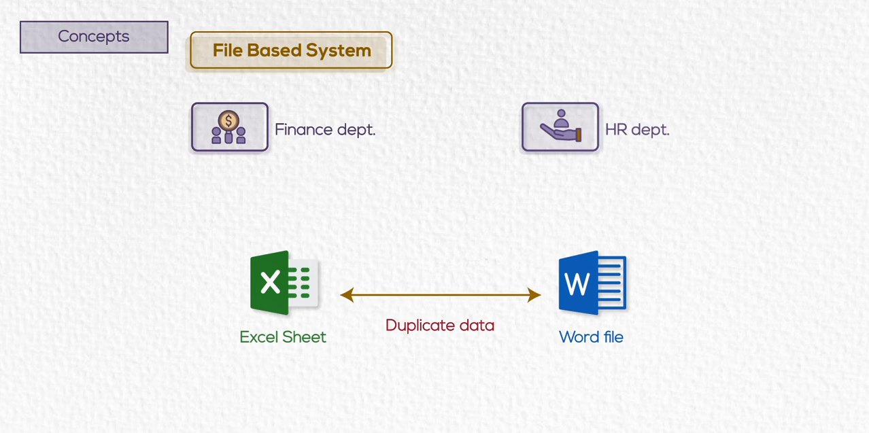
Before Database

Slide 15
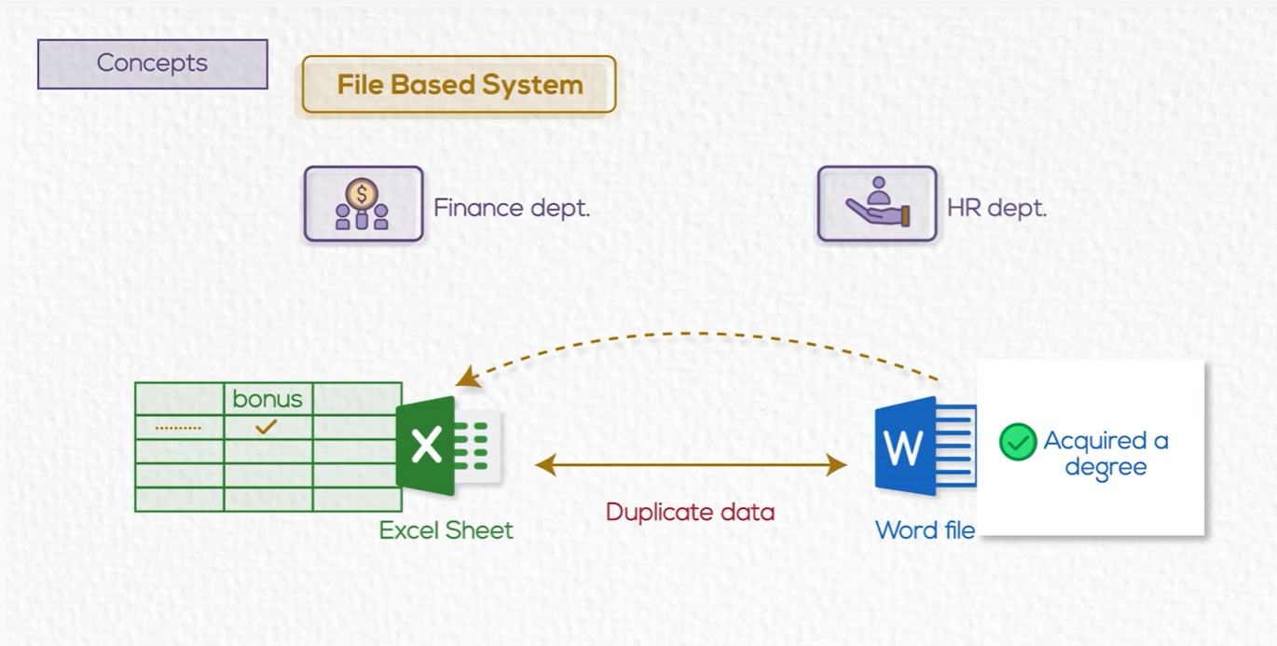
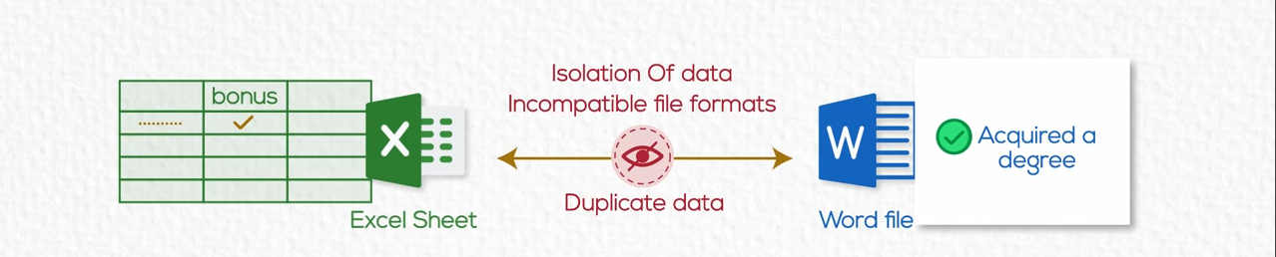
Before Database
An employee acquired a master degree

Slide 16
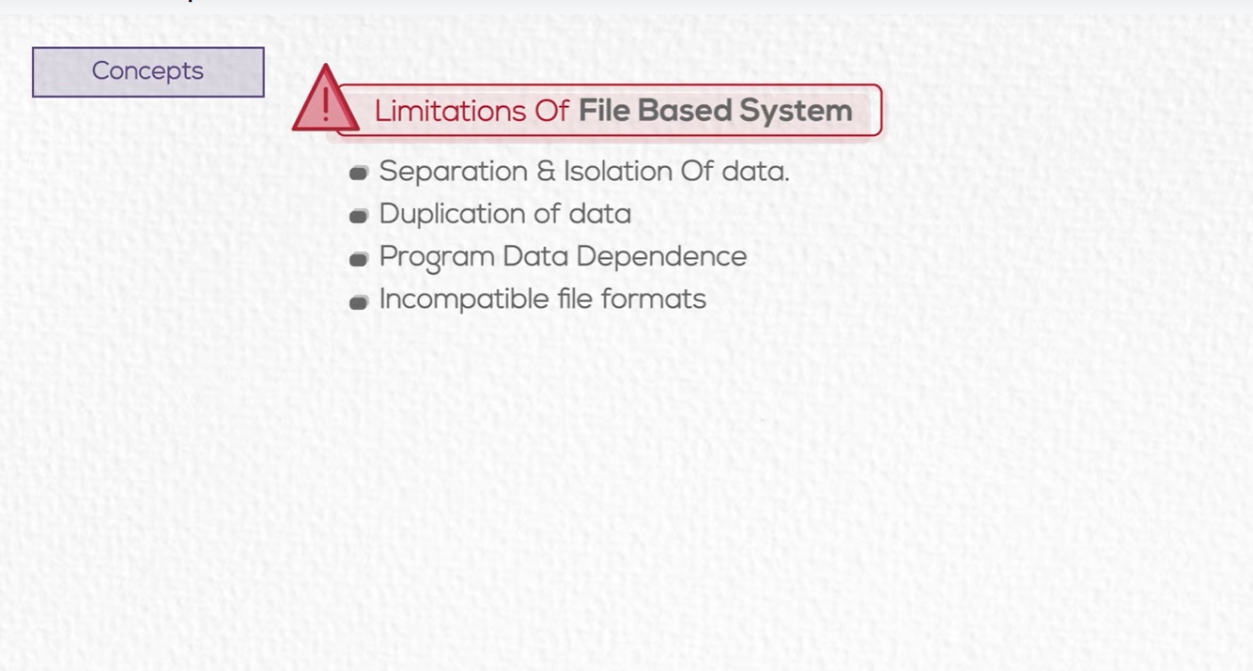
Before Database

Slide 17

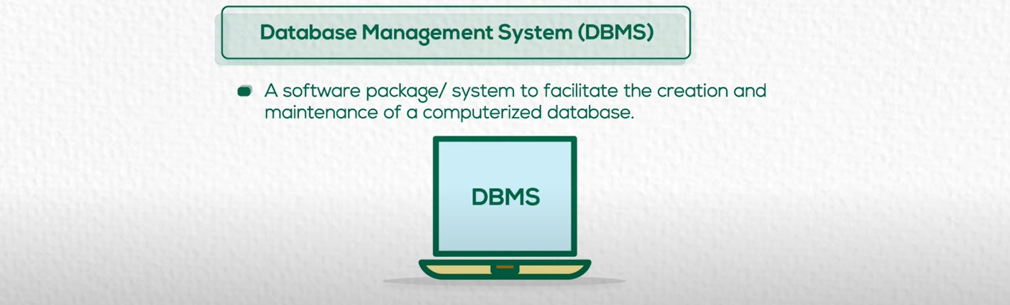

Slide 18
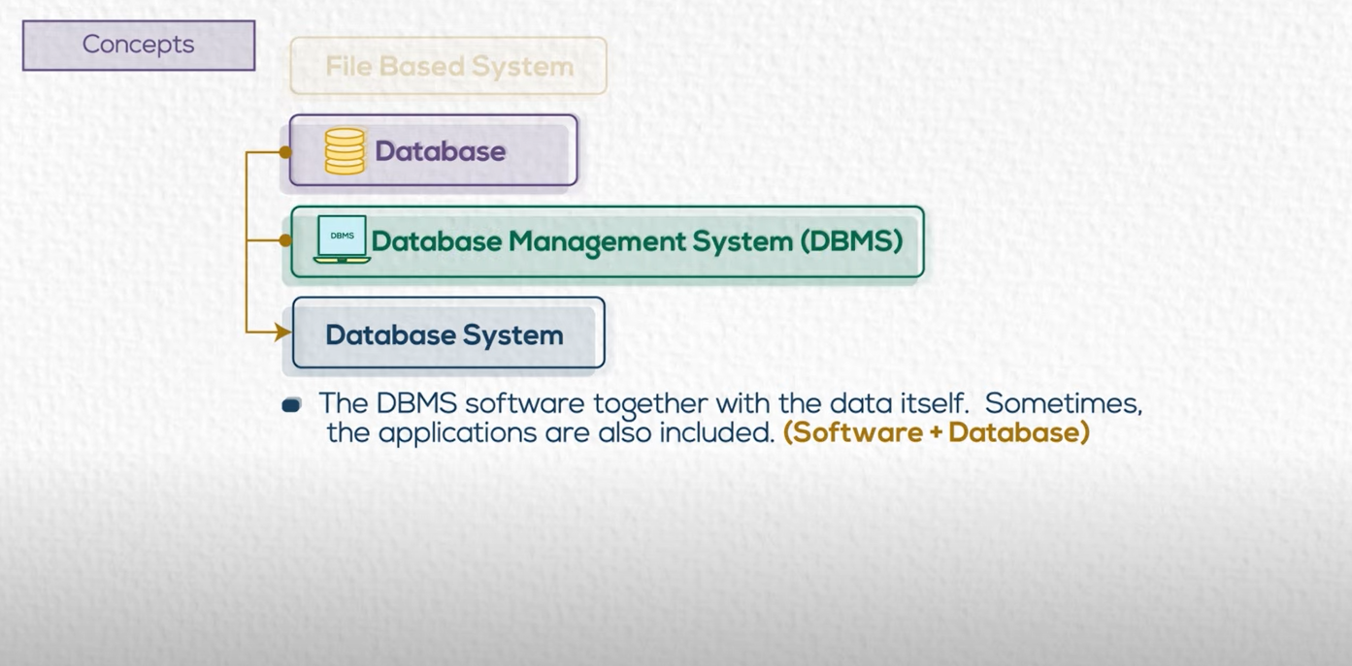

Slide 19


Slide 20
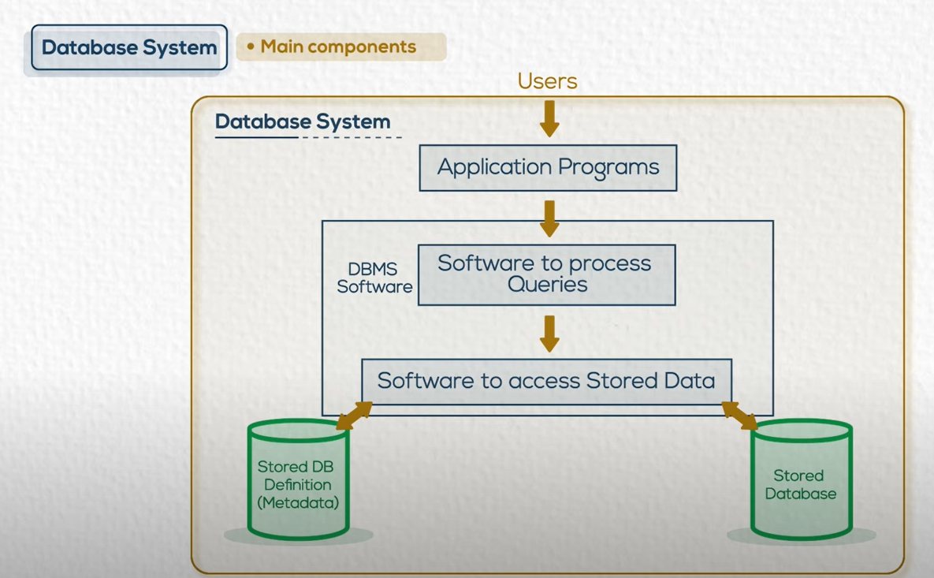

Slide 21
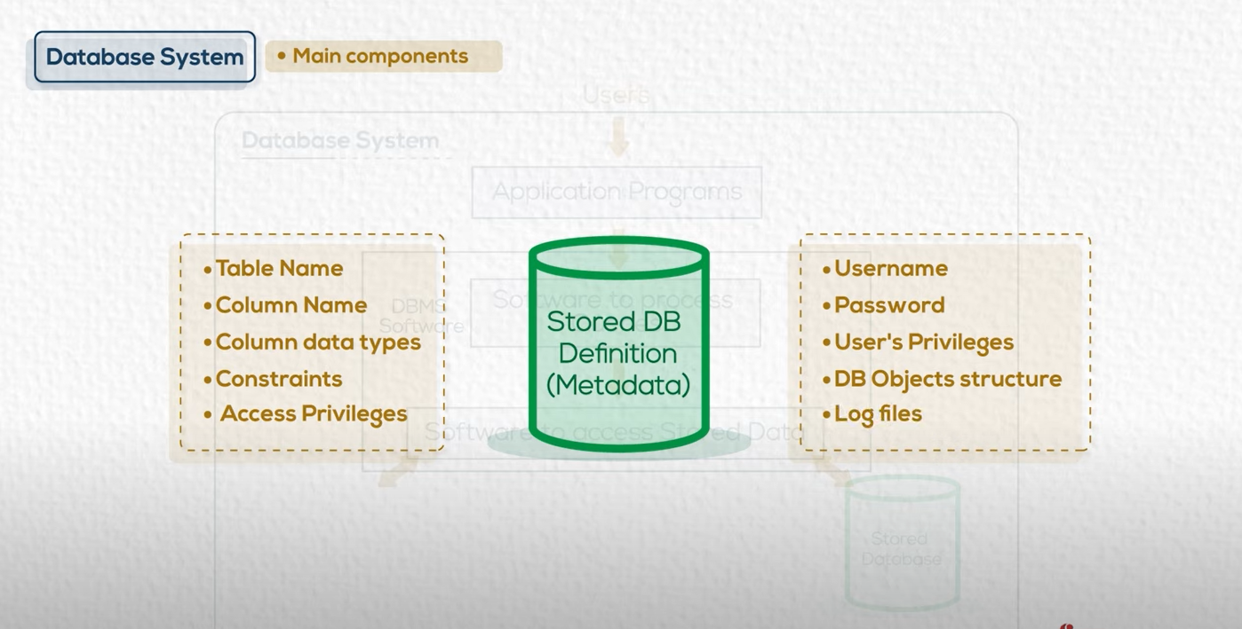


Slide 22
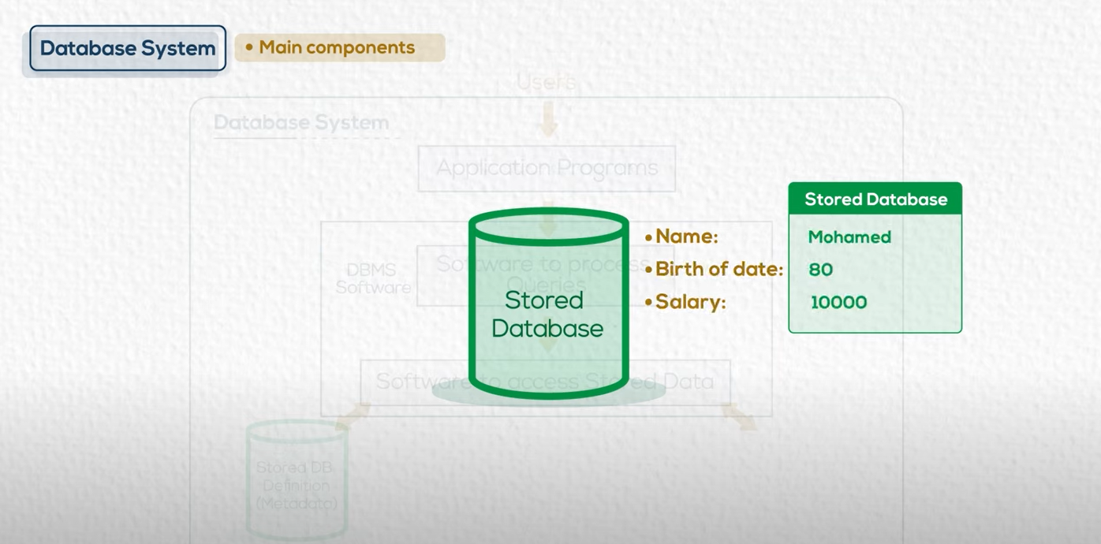

Slide 23
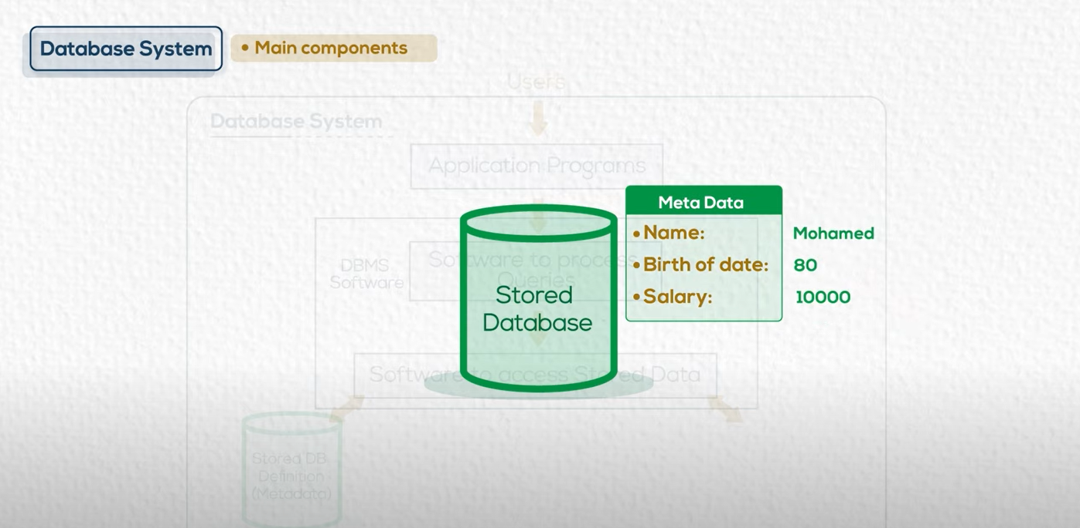

Slide 24
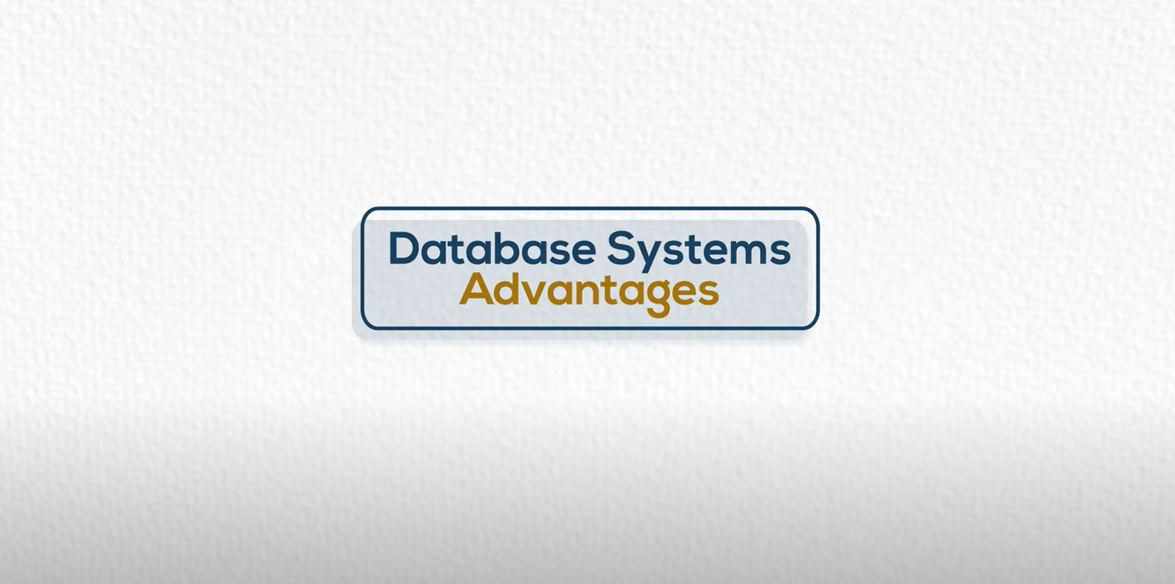

Slide 25
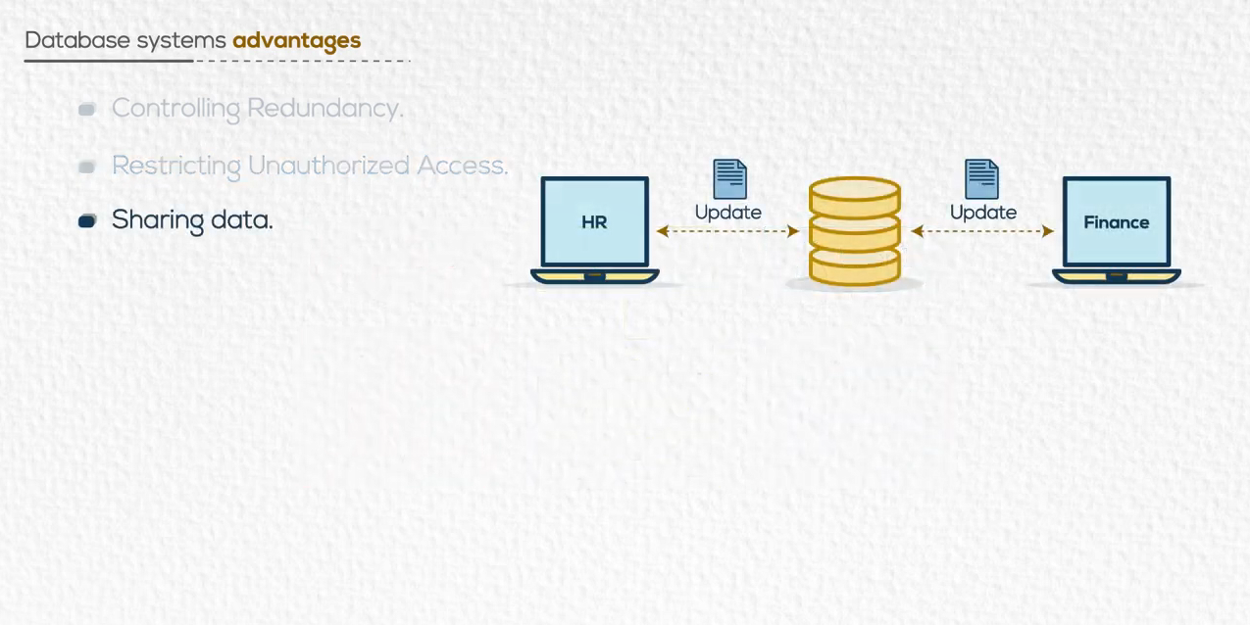
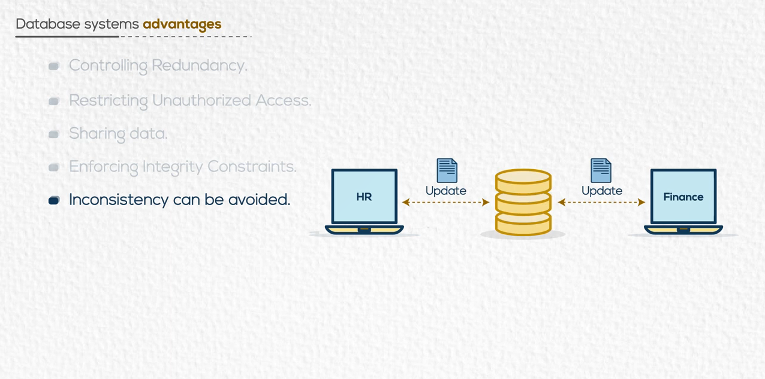
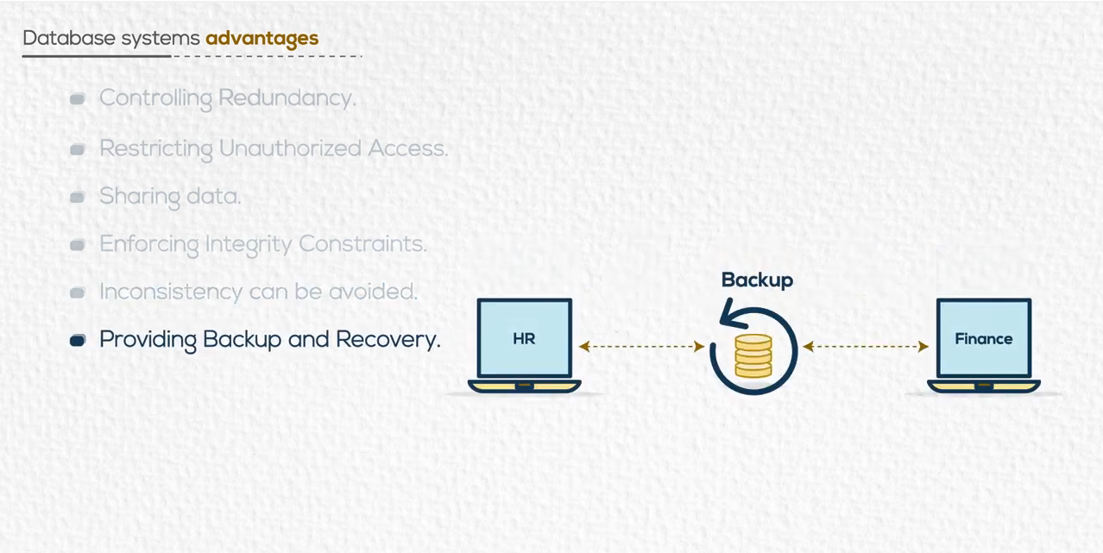
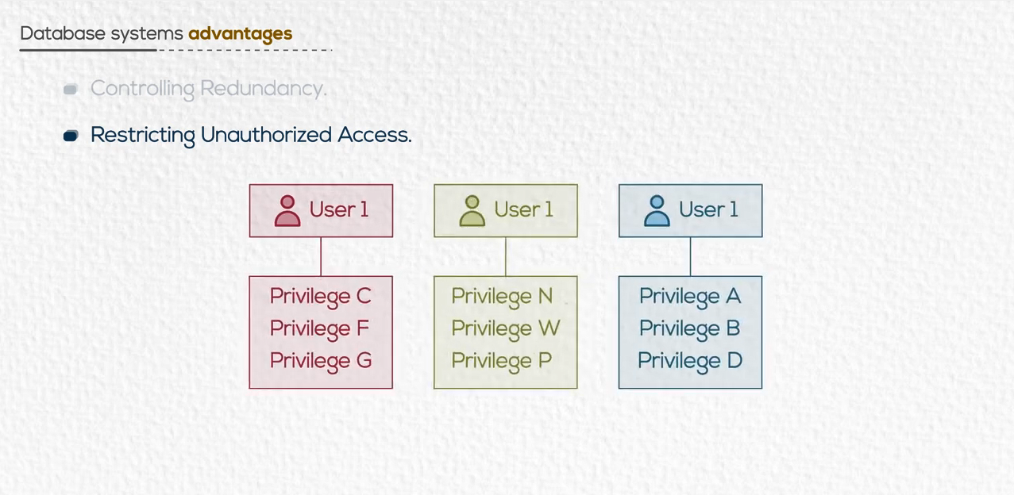
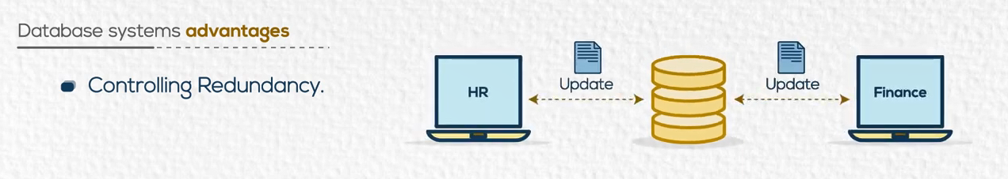
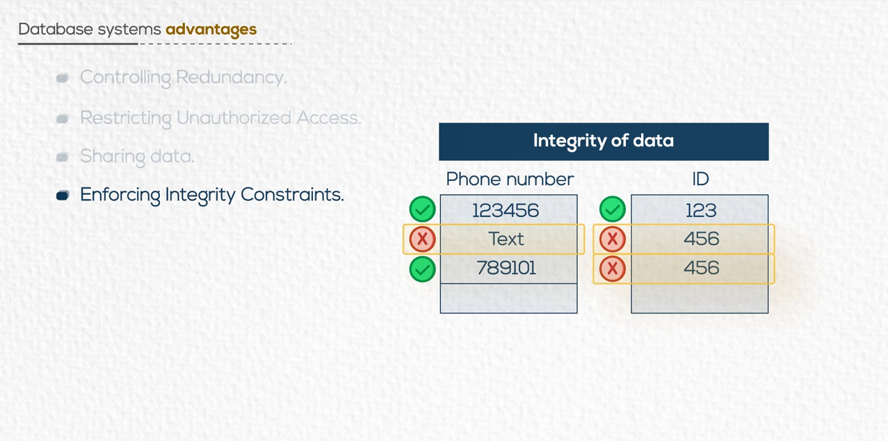
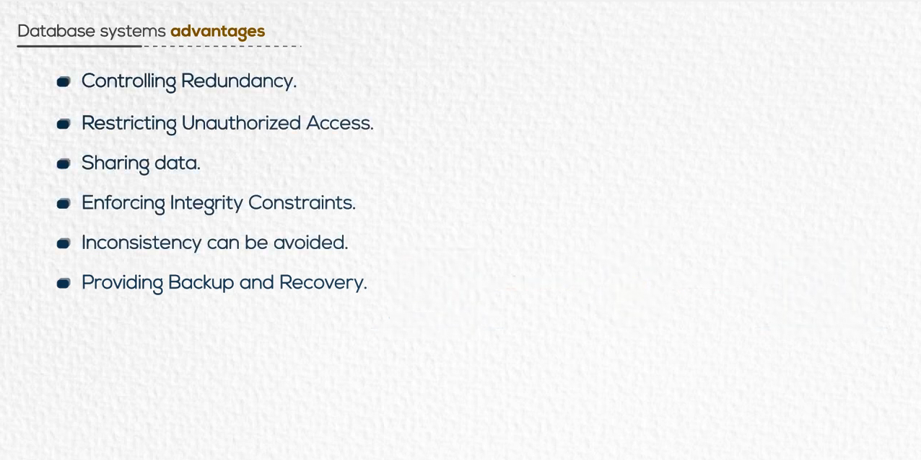
Apply Business Rules

Slide 26
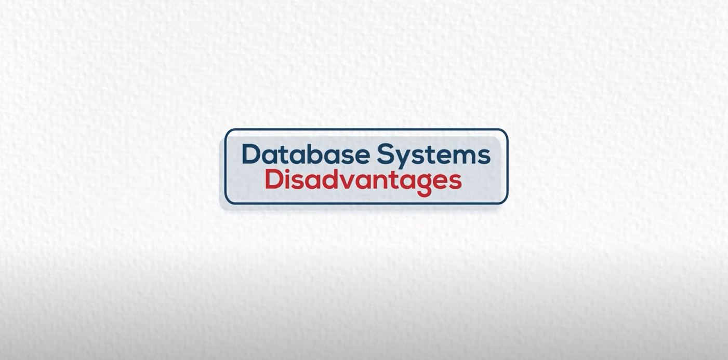

Slide 27
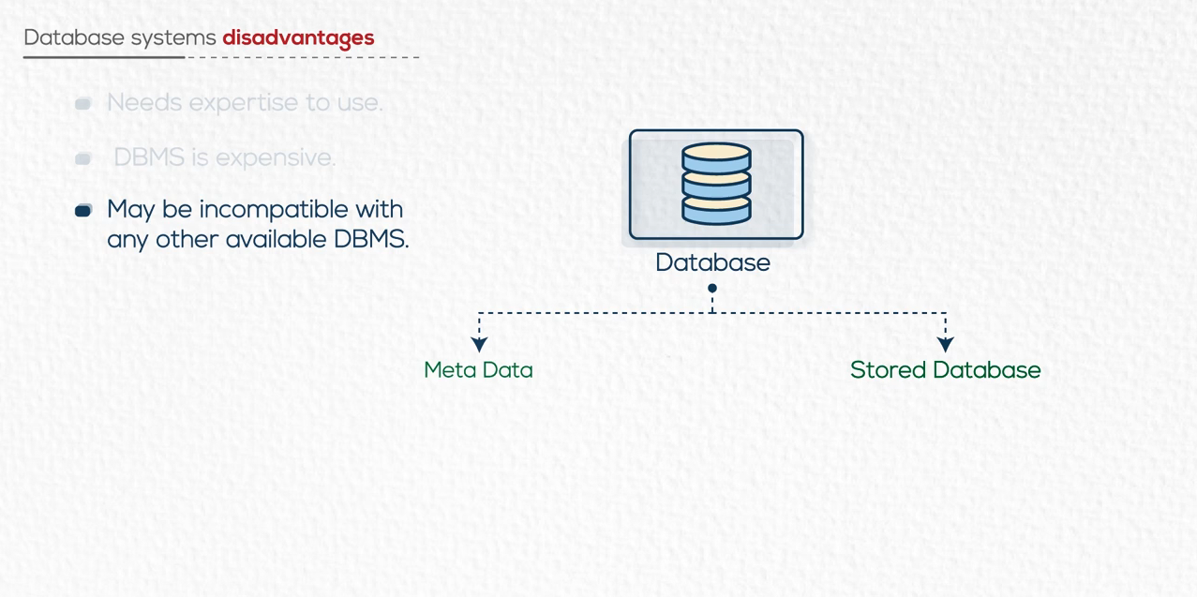
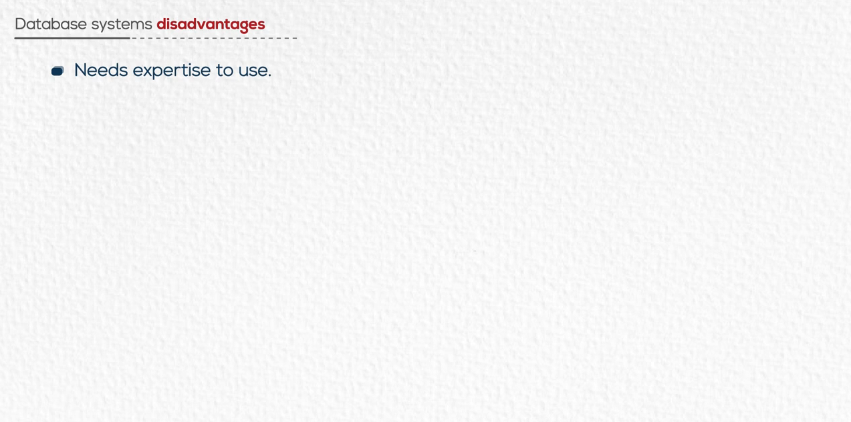
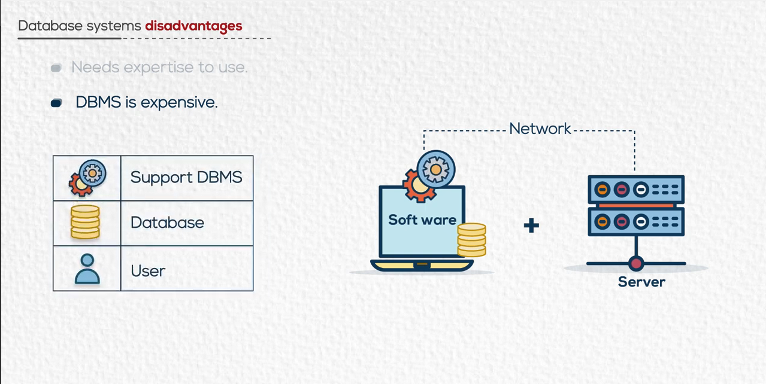


Example :

Slide 28


Slide 29
Cycle of Creating Database

Slide 30
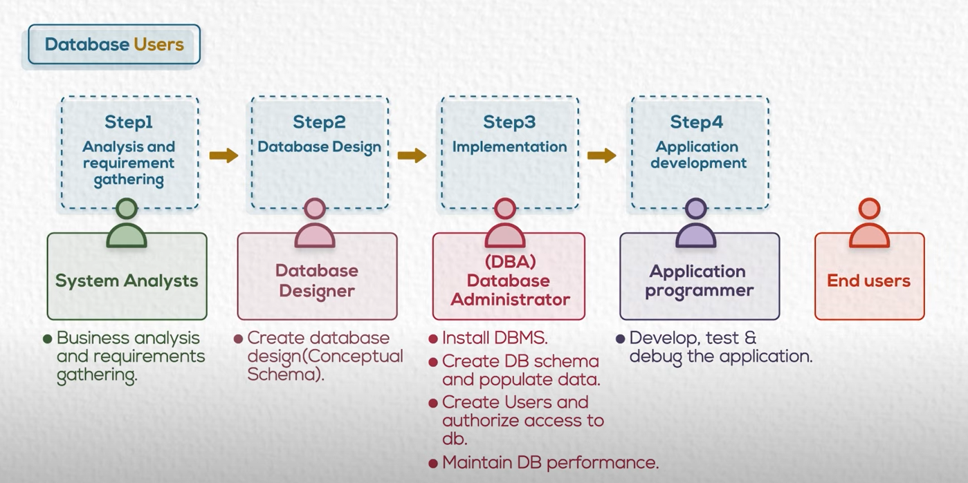
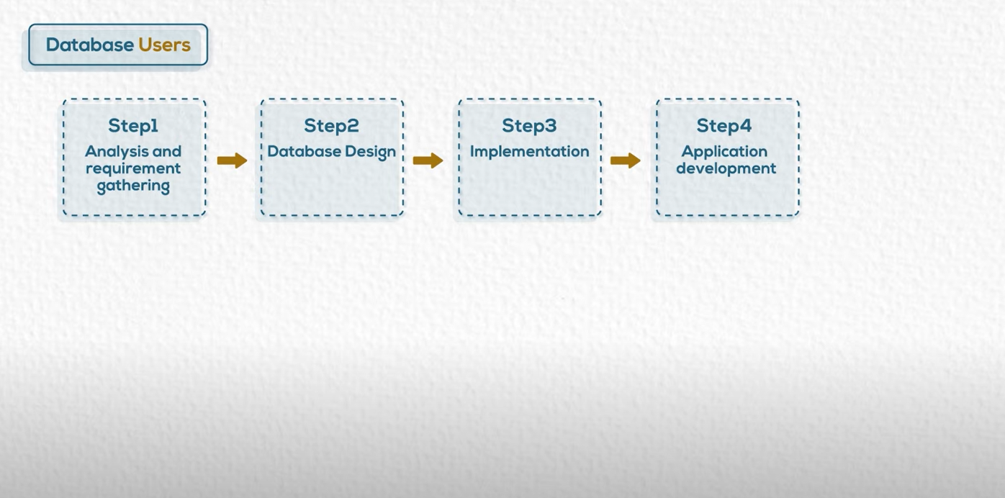

Slide 31
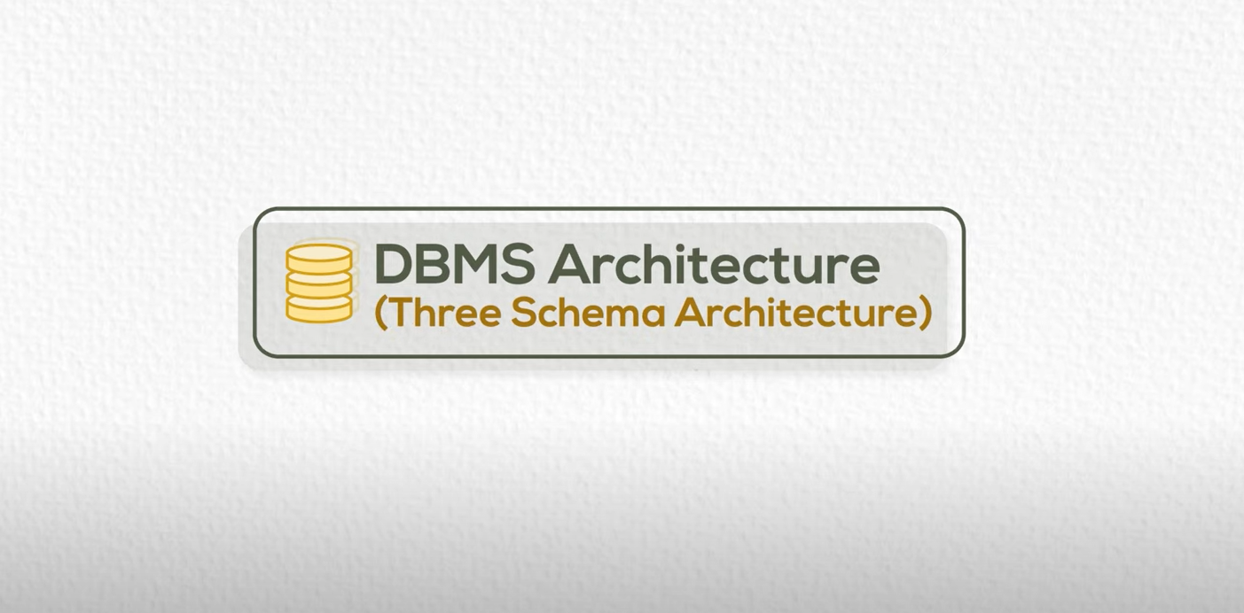

Slide 32
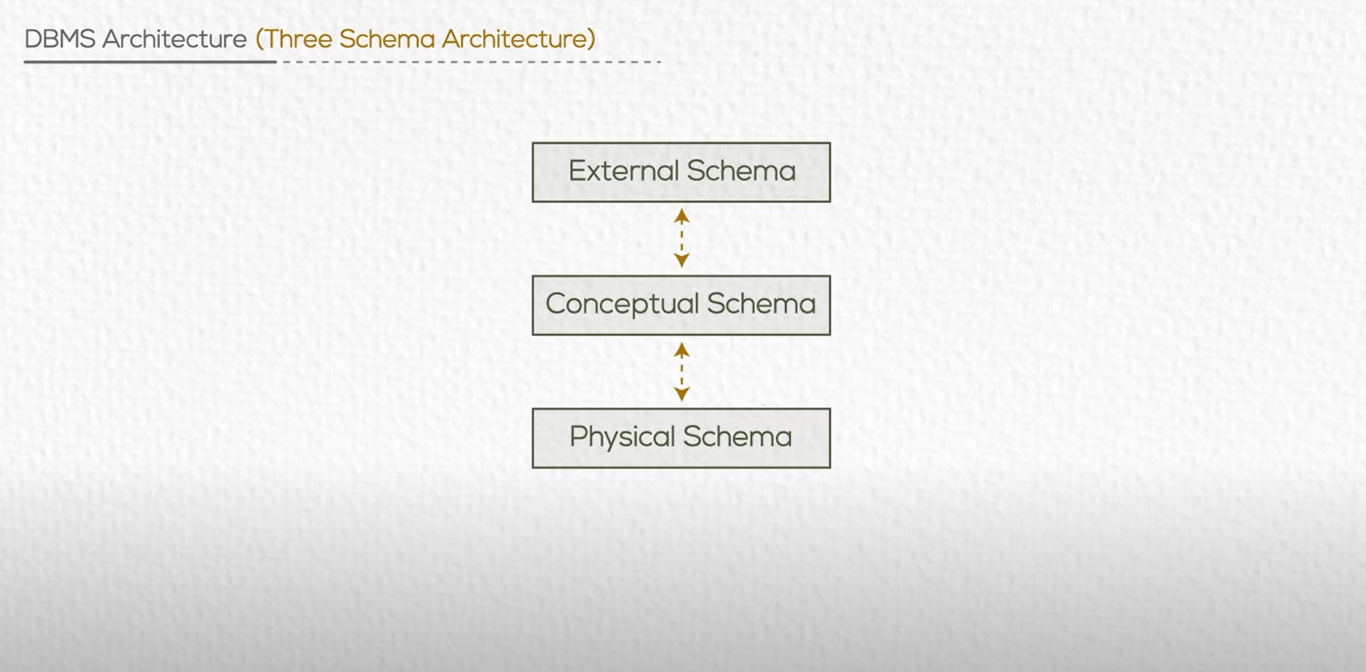

Slide 33
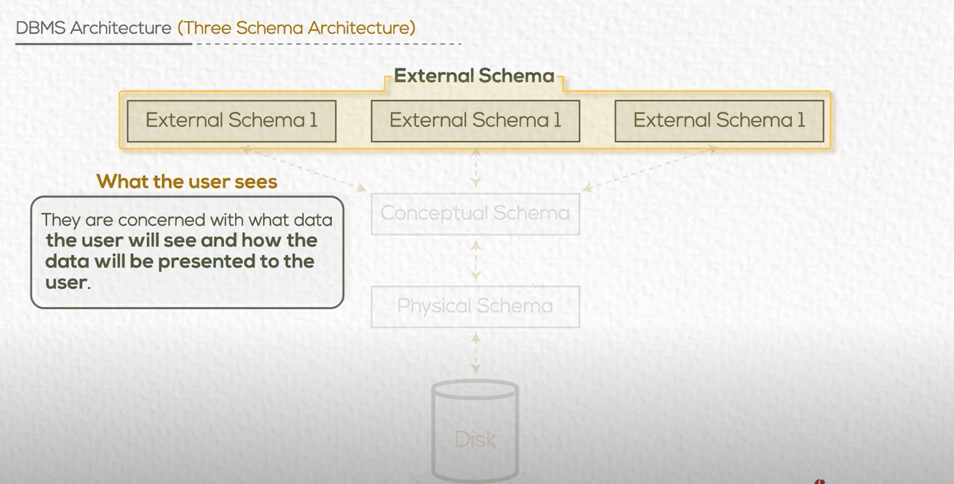
Ex: Financial Schema , HR Schema

Slide 34
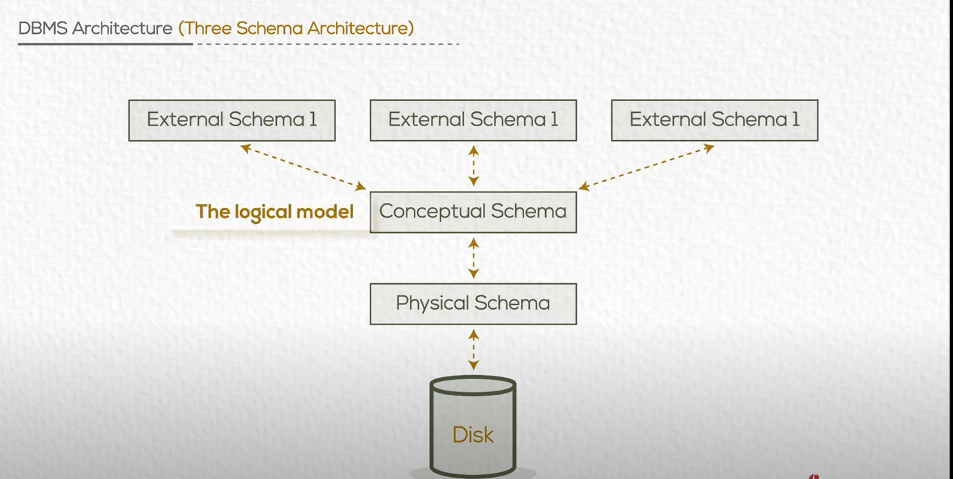

Slide 35
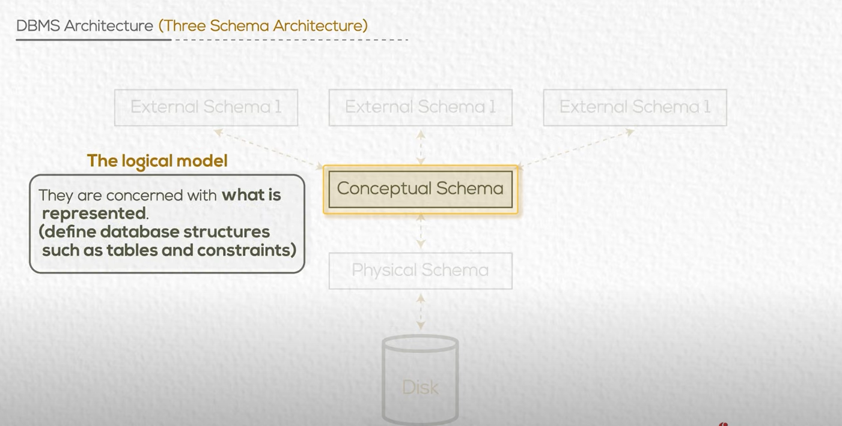

Slide 36
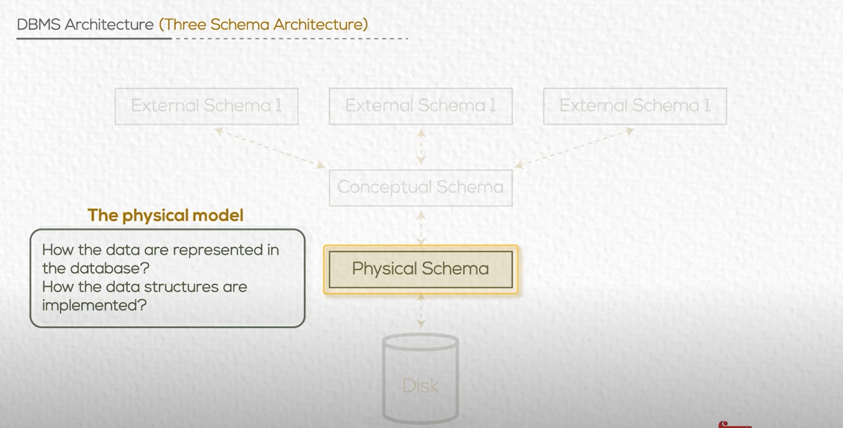

Slide 37
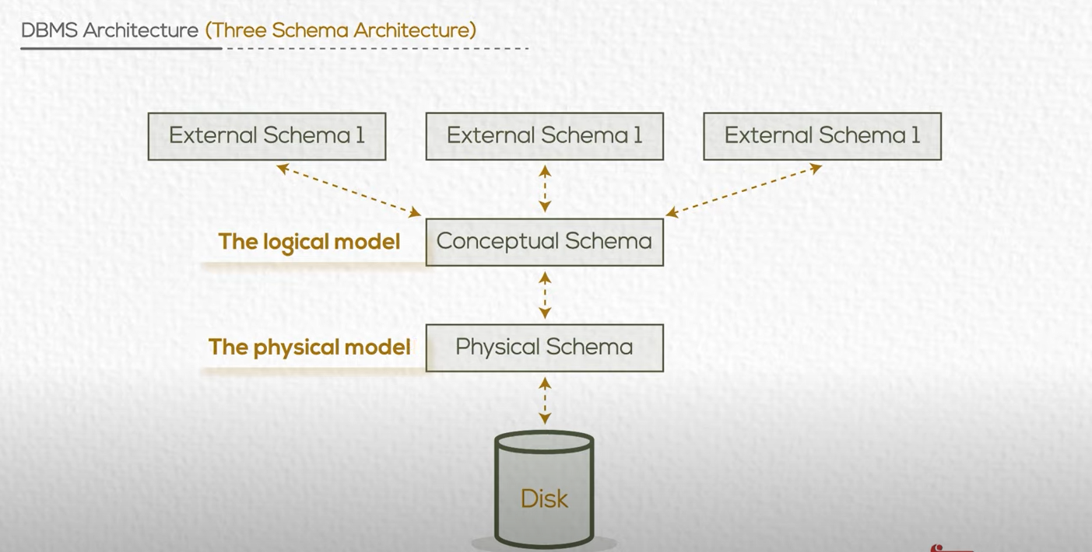
Why 3 schema? For data independence

Slide 38


Slide 39
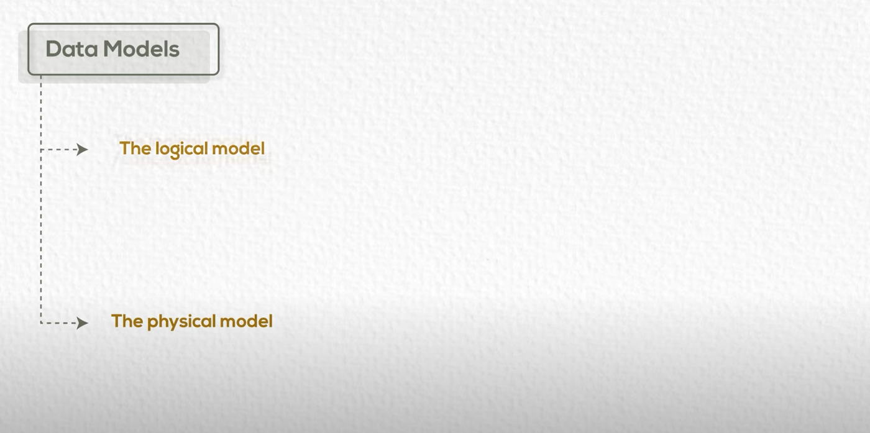

Slide 40
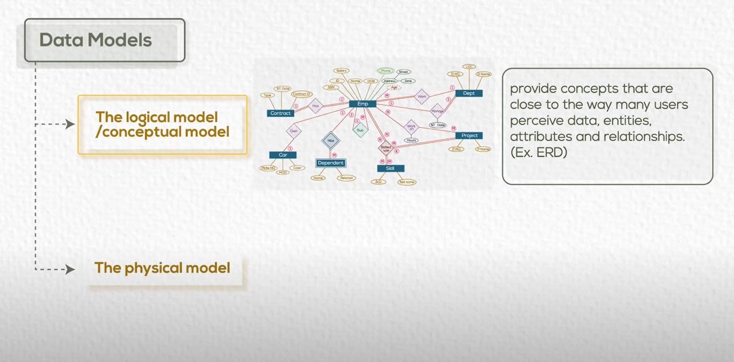
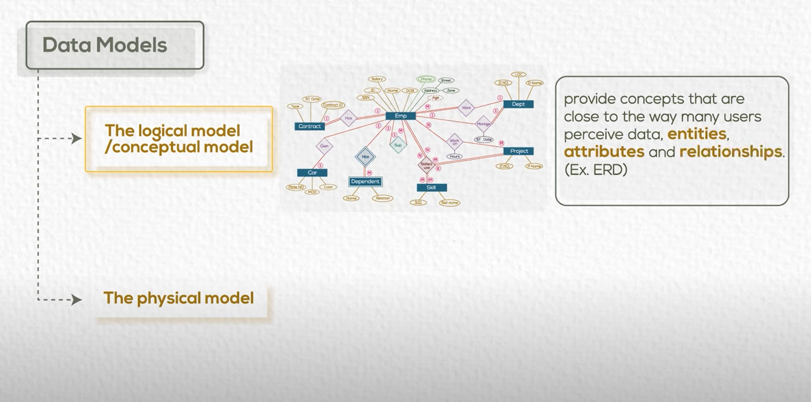

Slide 41
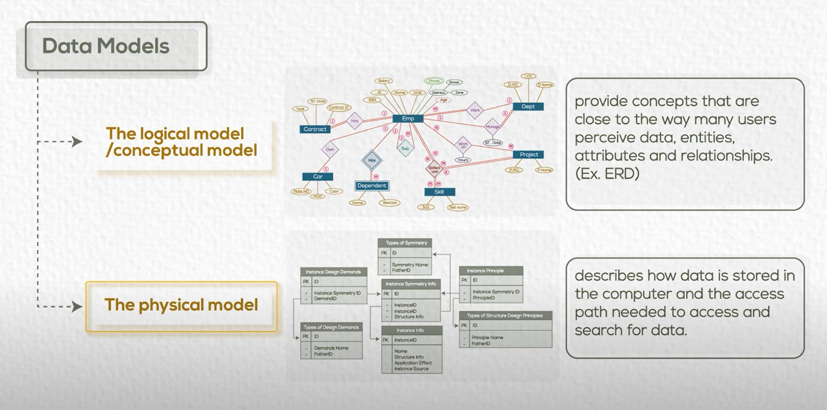

Slide 42
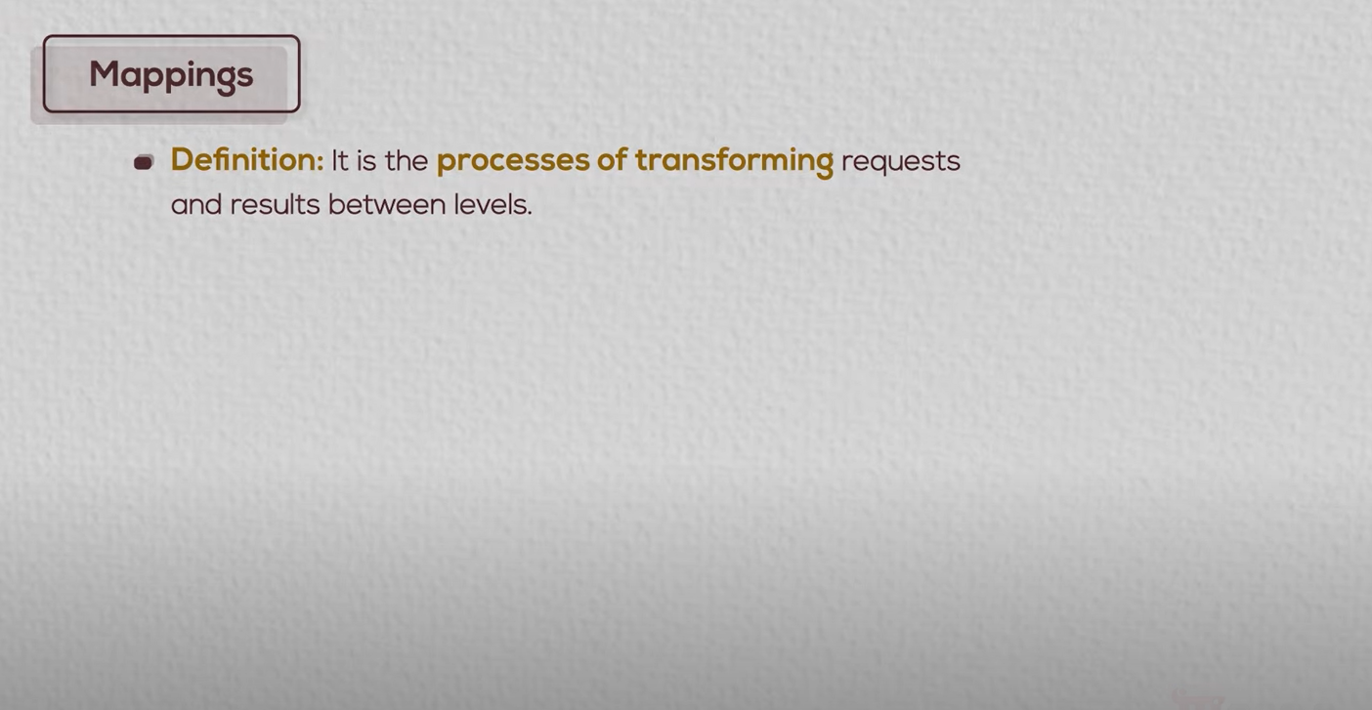

Slide 43
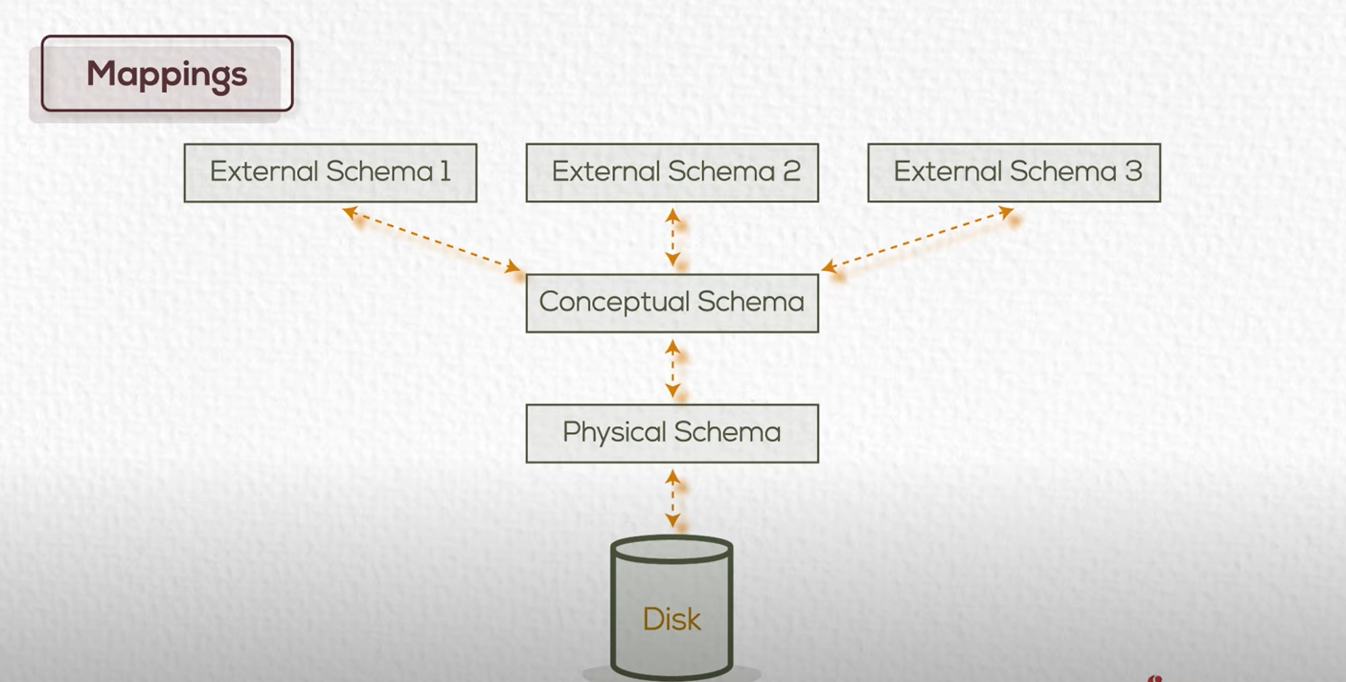



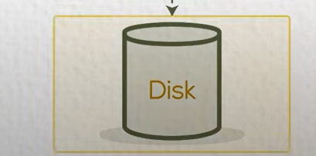

Slide 44


Slide 45
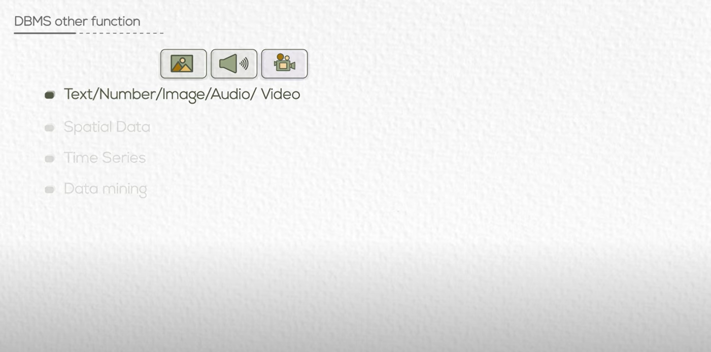

Slide 46
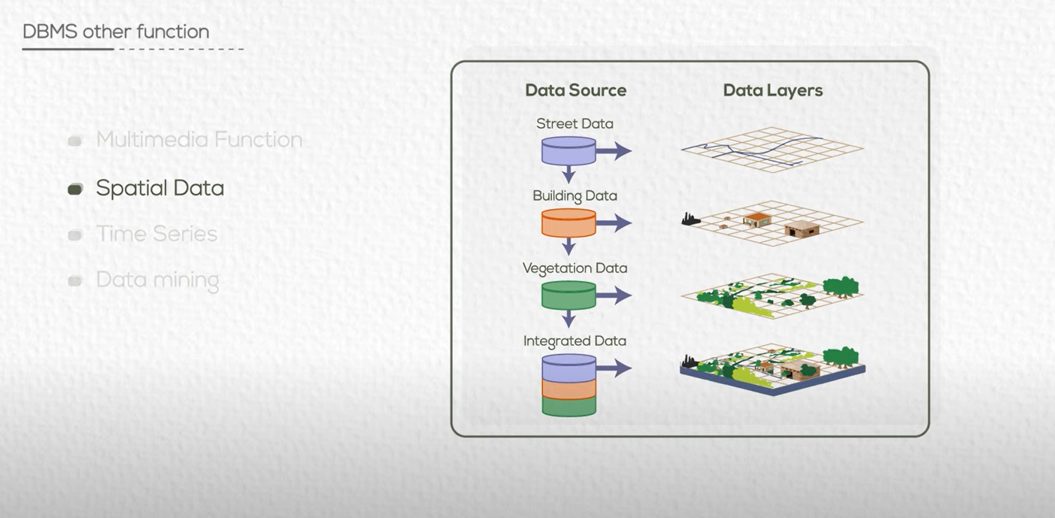
GIS

Slide 47
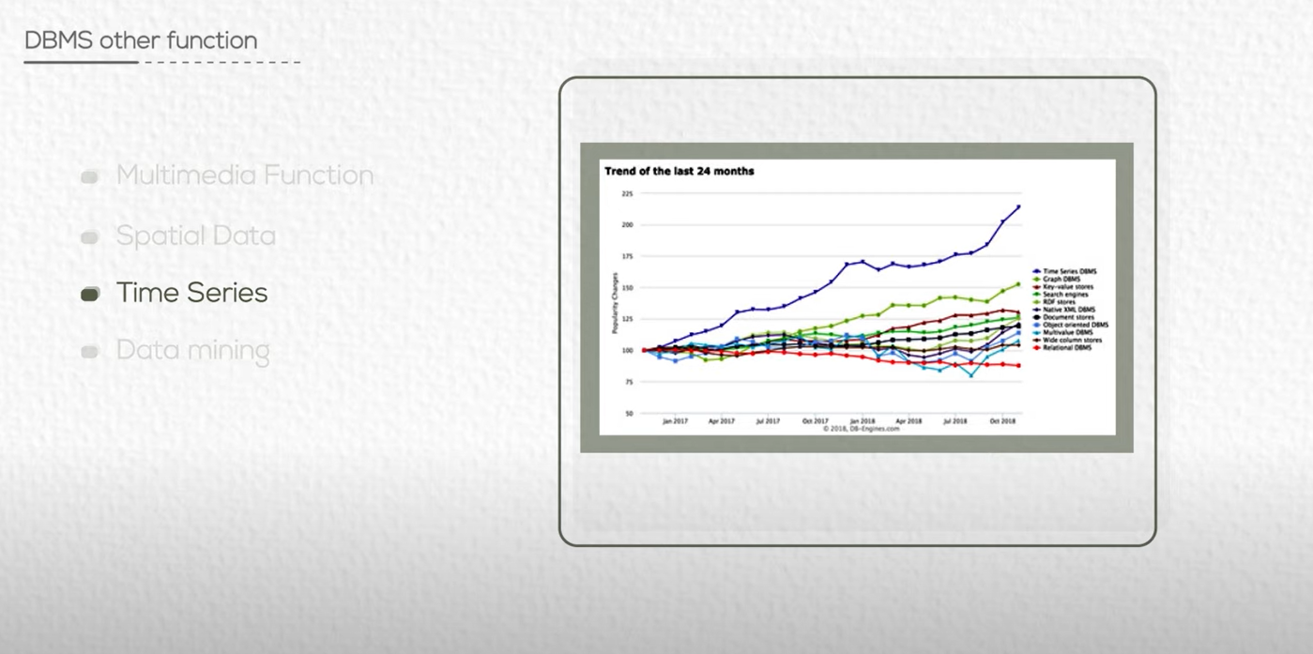
بيانات البورصة

Slide 48
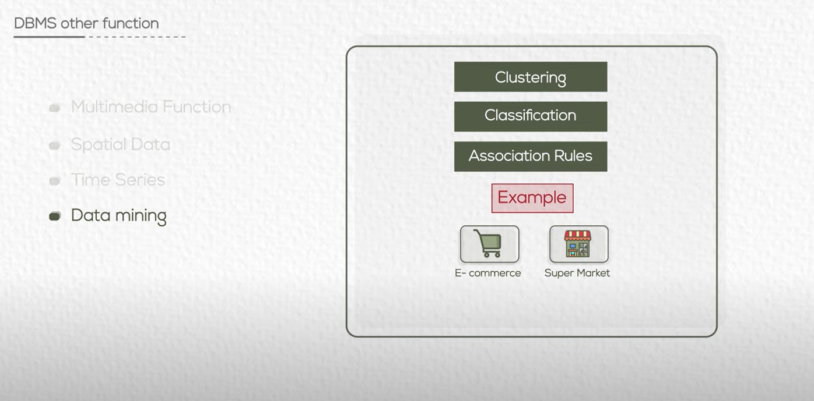
Ex: classify users of supermarket

Slide 49


Slide 50


Slide 51
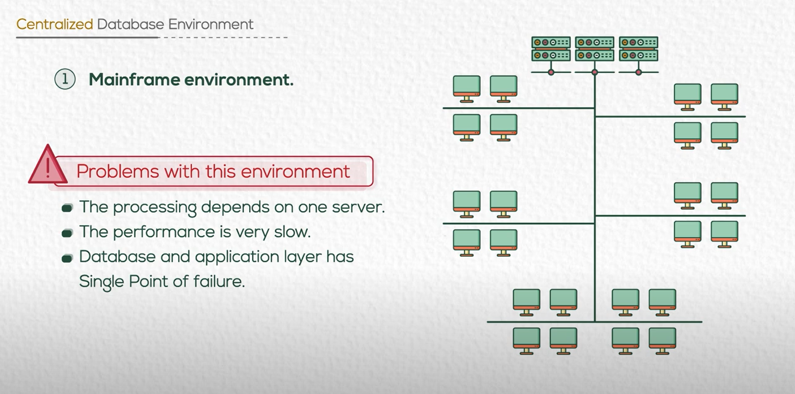
DB + App Server

Slide 52
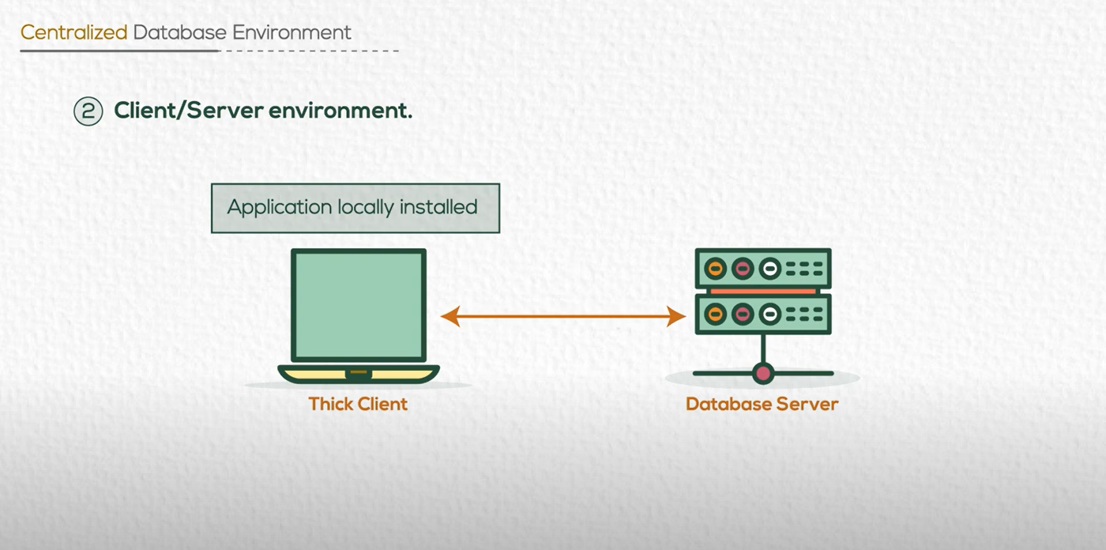

Slide 53

(For App Update)

Slide 54


Slide 55

(For App Update)

Slide 56


Slide 57


Slide 58


Slide 59


Slide 60




Slide 61

columns
Records

Slide 62




Slide 63


Slide 64


Slide 65


Slide 66


Slide 67


